Slide 1
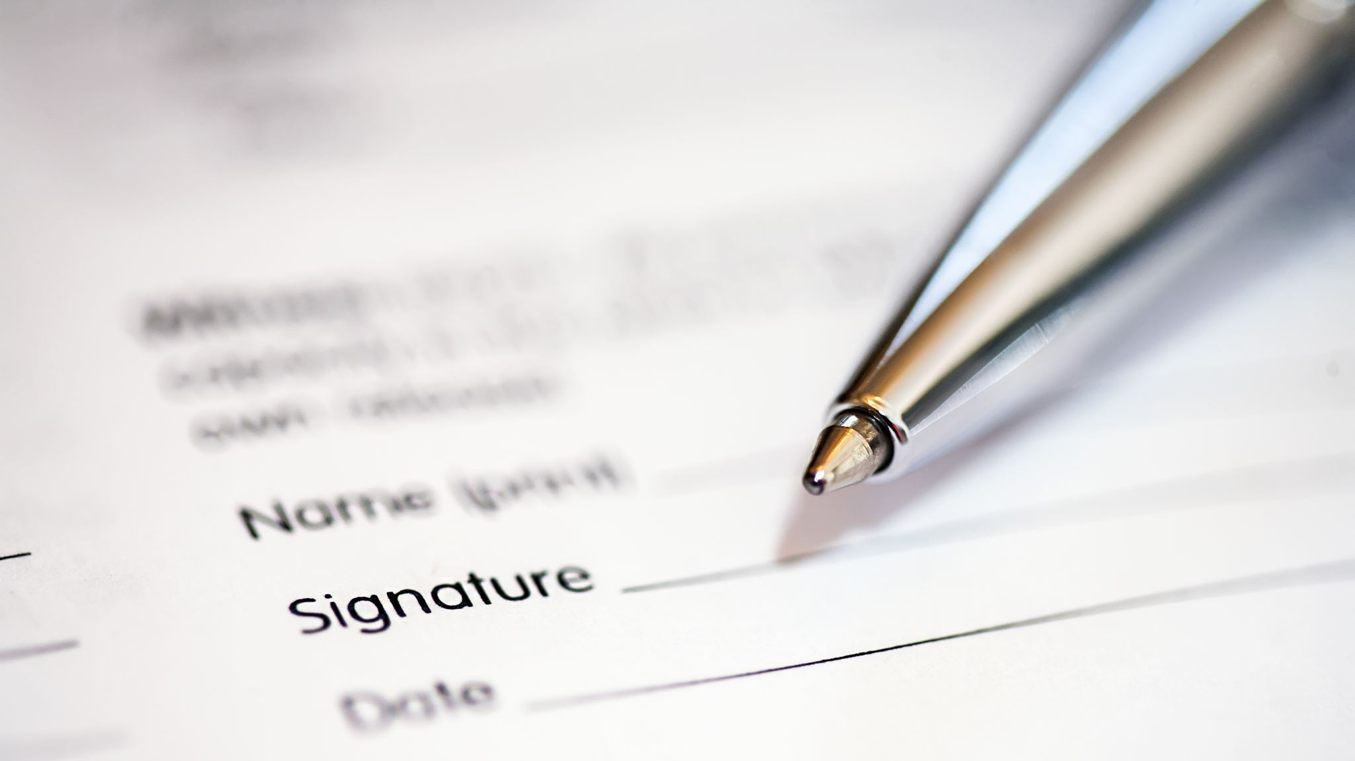
Submitting a AG report: who, what, how, and why

Slide 2
What is the scope of the investigation?
“Every student on Long Island and across New York deserves to feel safe and protected at school. The reports of sexual abuse of students at the hands of their teachers and coaches are troubling and must be investigated. My office is launching an investigation into the Babylon School District over these disturbing allegations. The safety and wellbeing of students — both past and present — is of utmost importance, and we will do everything in our power to protect their right to a safe learning environment.”
– AG website

Slide 3
Who?
Anyone who has any information about misconduct at Babylon High School
  It doesn’t matter how long ago the incident was
  It doesn’t matter whether you have physical evidence; your testimony is evidence
  You can report things that did not happen directly to you, ie, you witnessed a coach act inappropriately or heard rumors about it
  Your experience of misconduct being normalized is very valuable
    Could be the only corroborating evidence for a survivor’s story
    Could provide evidence to show that there were “open secrets” – DON’T ASSUME THAT WHAT YOU KNOW WILL BE REPORTED BY SOMEONE ELSE JUST BECAUSE YOU THINK OTHERS KNOW.
Non-alumni can report if they have info about Babylon; AG is also accepting info about other schools through the same form

Slide 4
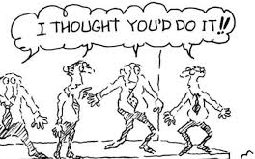
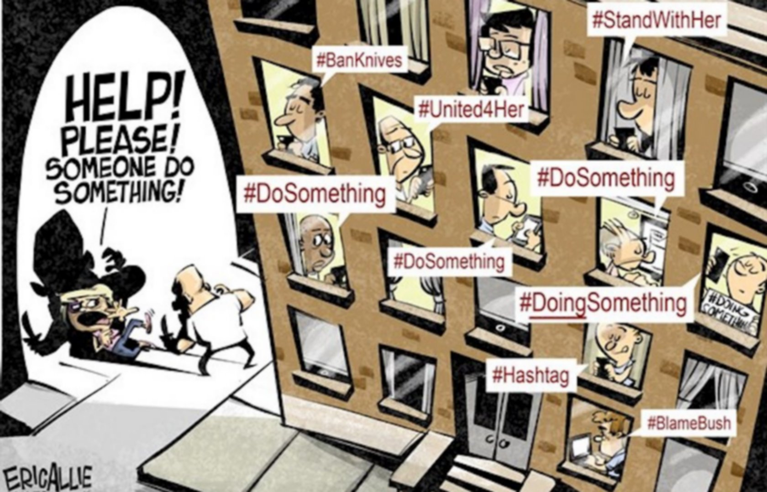

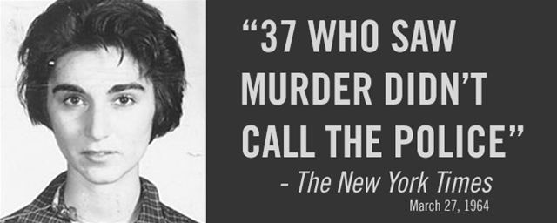

Slide 5
What?
If you have graduated from Babylon High School, your understanding of what was appropriate behavior or not may have been shaped in an environment that wasn’t equipped to do so.
  Ex. Many people felt it was appropriate to be texting teachers outside of class.
It will take some re-visiting
  Yearbooks
  Discussions with friends both inside and outside of Babylon
  Learning about common types of misconduct in schools, ie, grooming
  Make sure to keep yourself safe if revisiting these years is painful; have a plan (ie, scheduled self-care activities, go-to coping tools)
Trust your gut, you are the expert on your life
Take note if you’re going back and forth a lot – may be time to talk it out

Slide 6
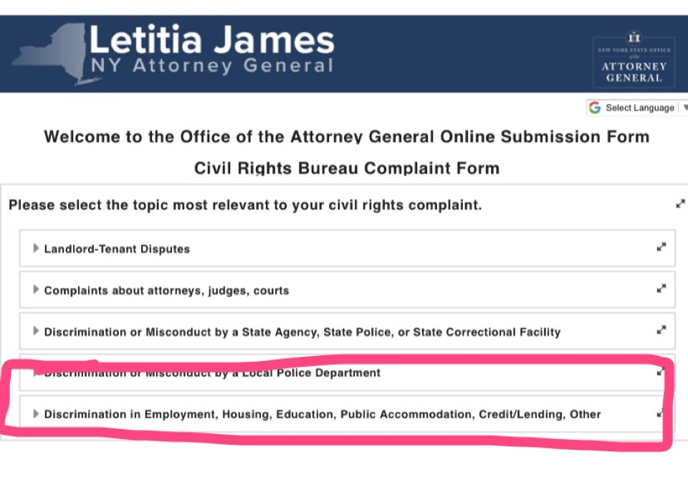
How?

Slide 7
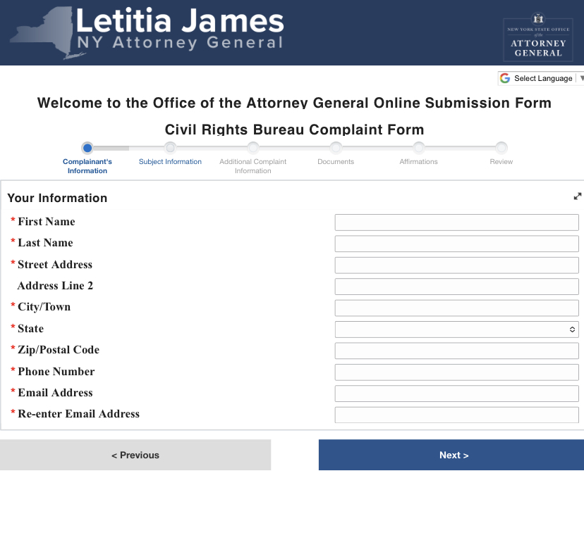

Slide 8
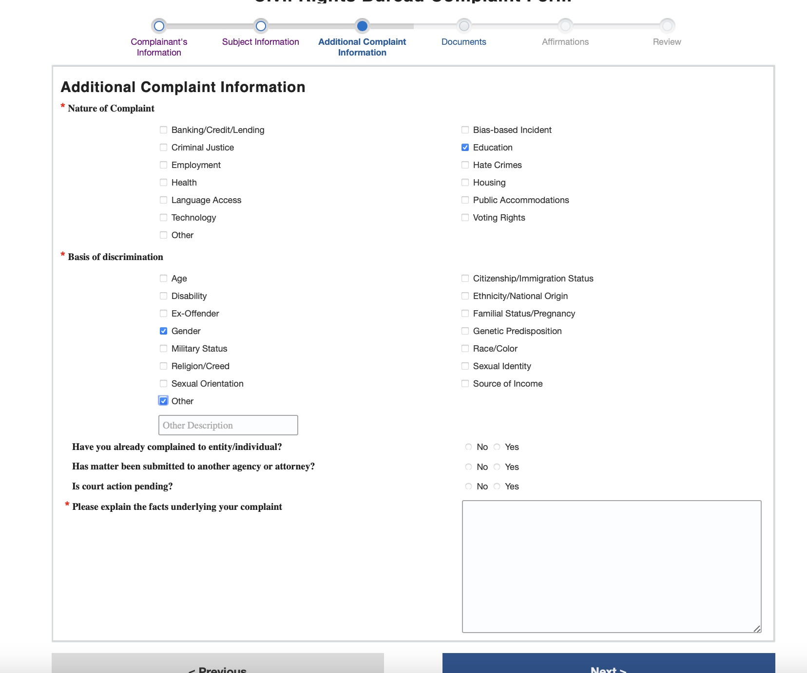

Slide 9
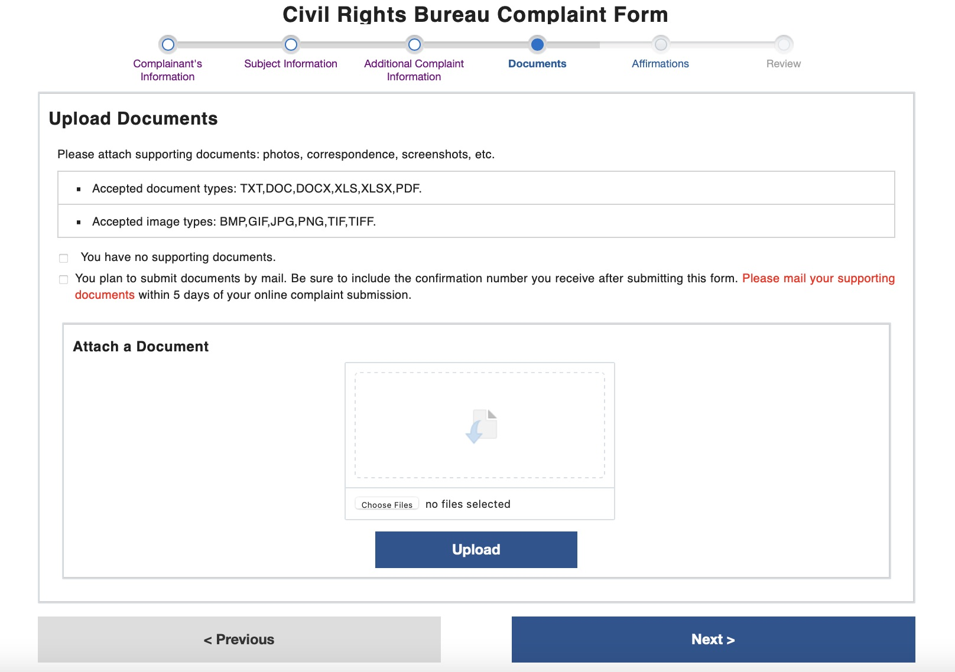

Slide 10
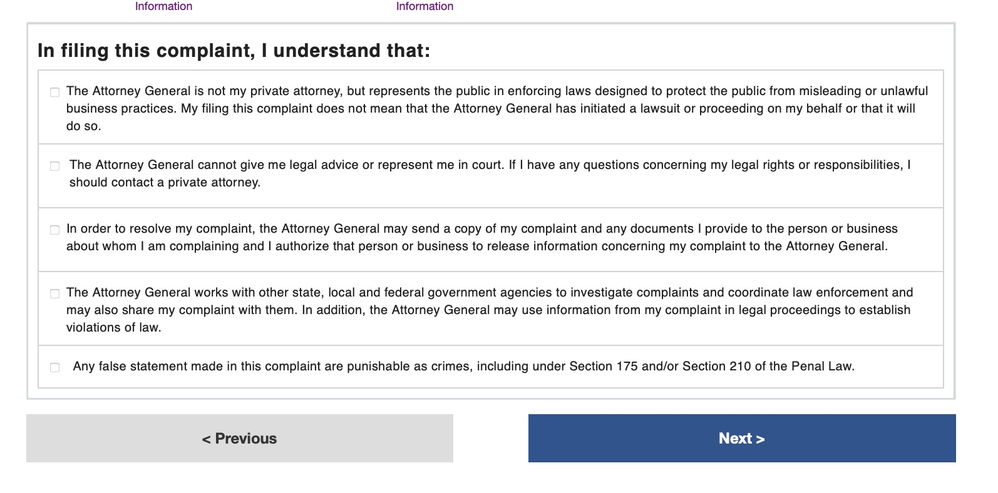

Slide 11
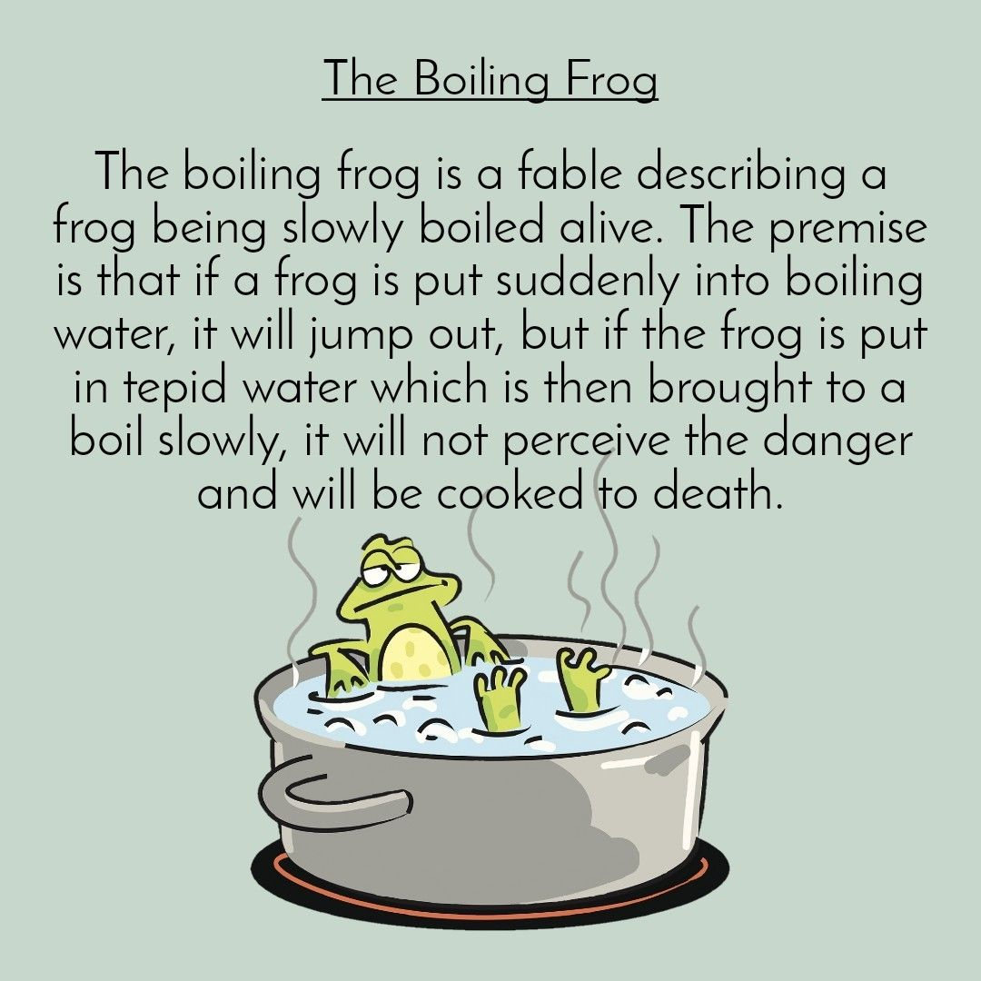
Why?

Slide 12
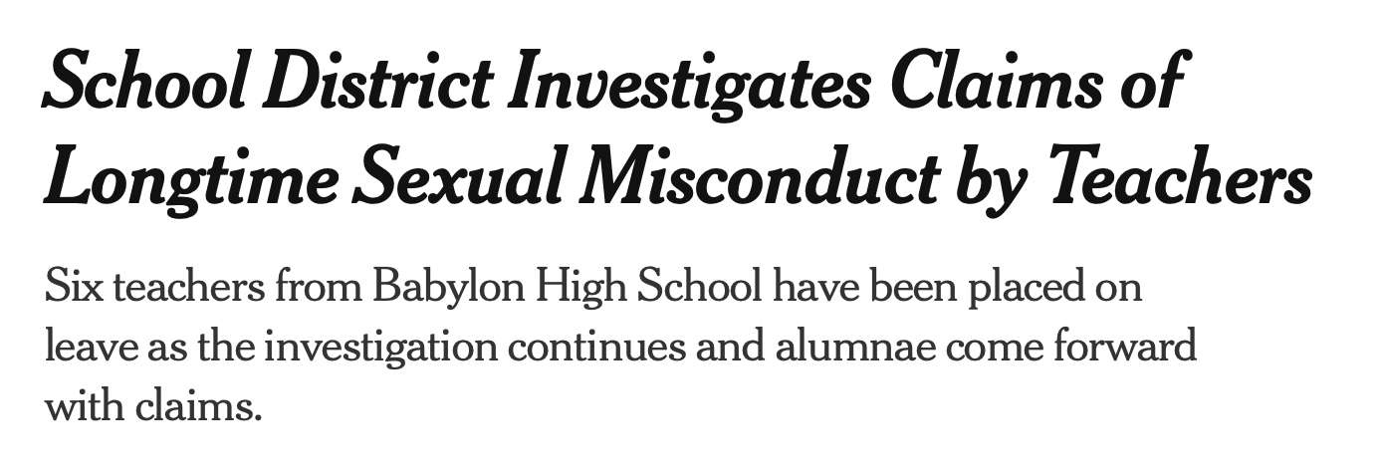
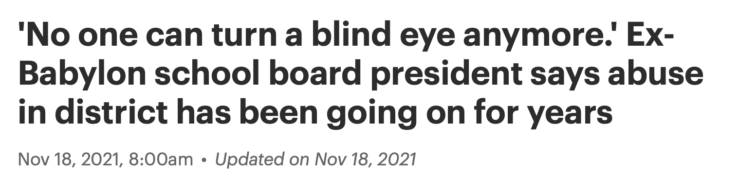

Slide 13
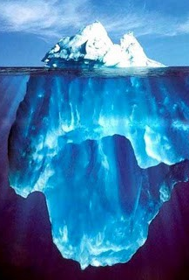
The tip of the iceberg
What underlies an environment where potentially a dozen predators feel comfortable harming children?
  Knowledge of prior inappropriate behavior gone unaddressed
  Inappropriate behavior becoming the norm
  Confusion about what is vs. is not appropriate
  Feeling that you won’t be believed
  Fear of retaliation
  Internalized rape culture (ex. It must have been my fault, etc)
  Indicators that rape culture is accepted (ie, sexist jokes, unwelcome non-sexual touching)

Slide 14
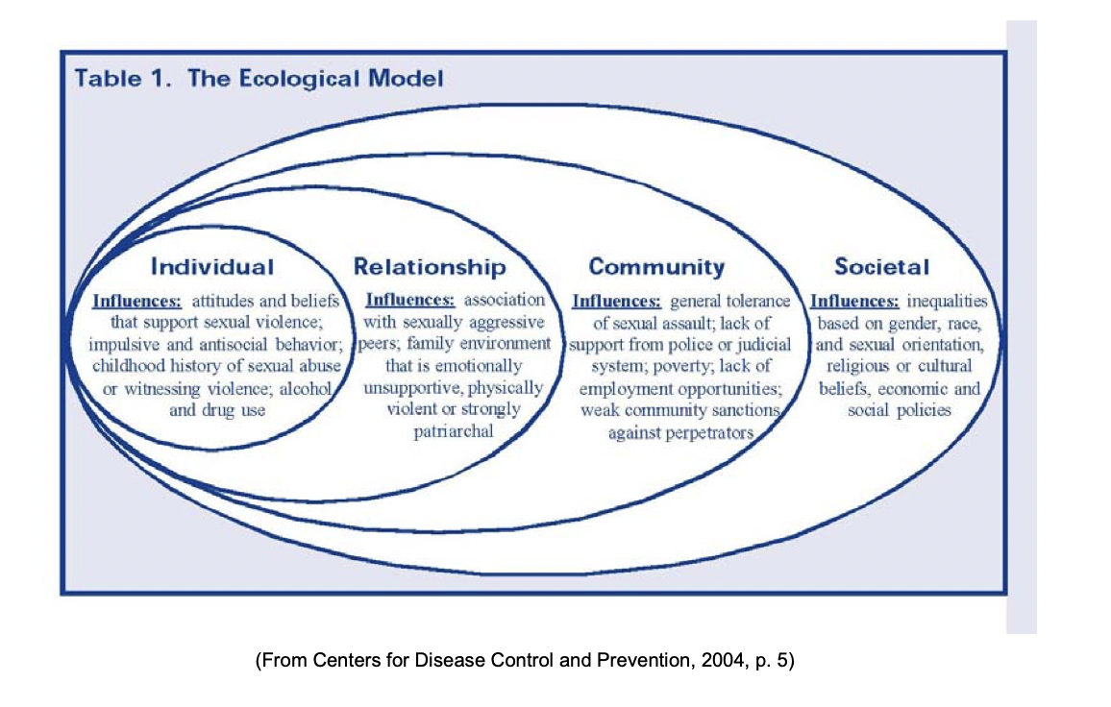

Slide 15
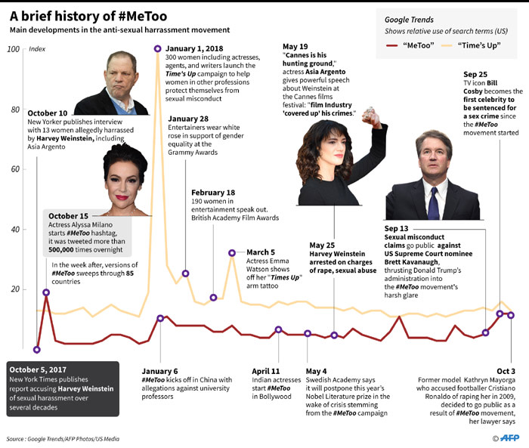
Current BHS seniors were in 8th grade.
Notes:
2021 seniors 2020 juniors 2019 sophomores 2018 freshman 2017 8th grade

Slide 16
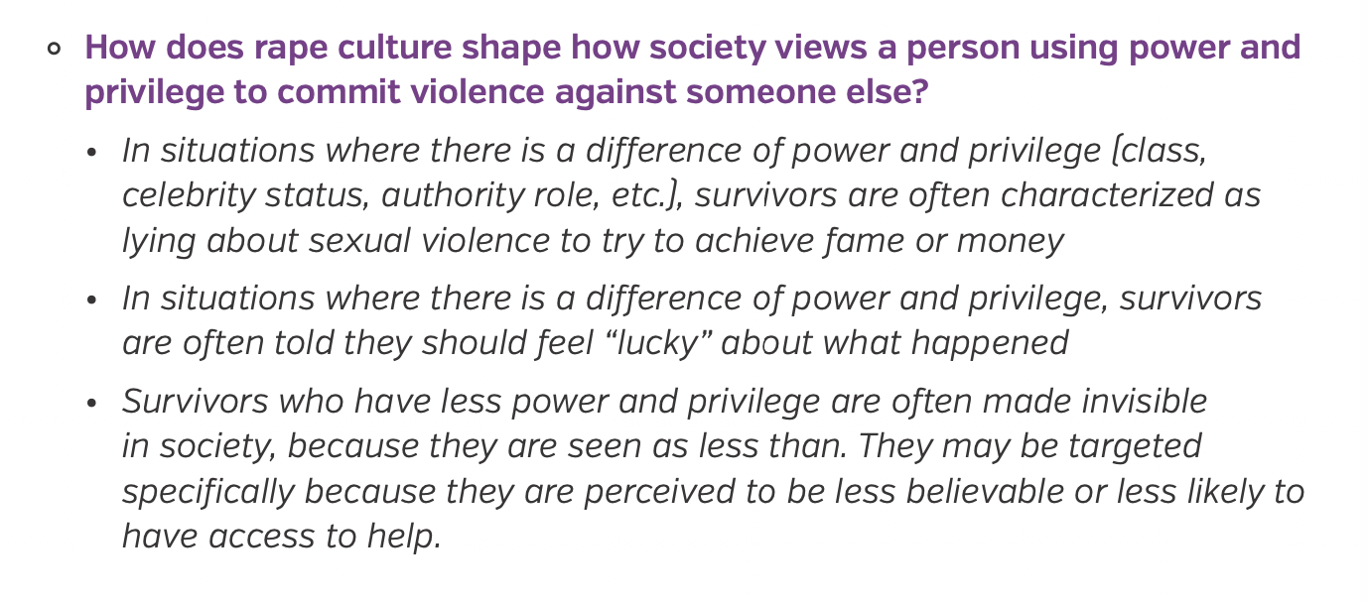

Slide 17
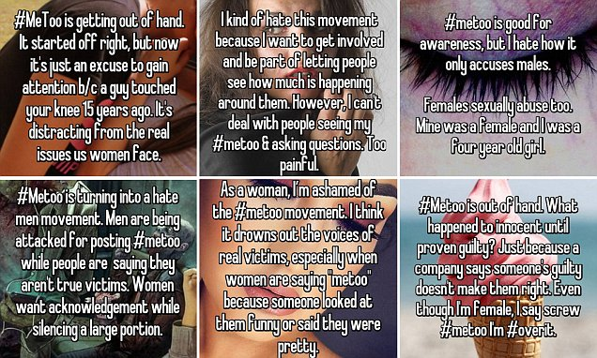

Slide 18
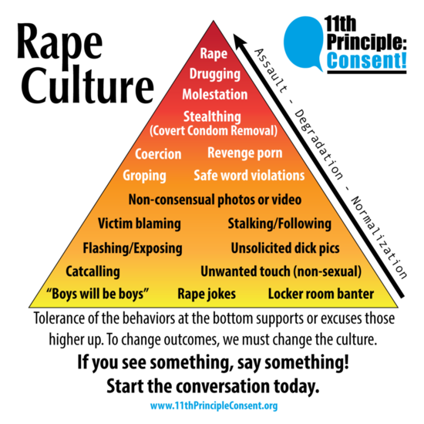
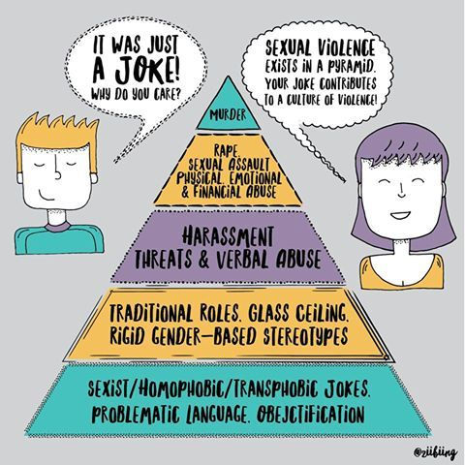

Slide 19
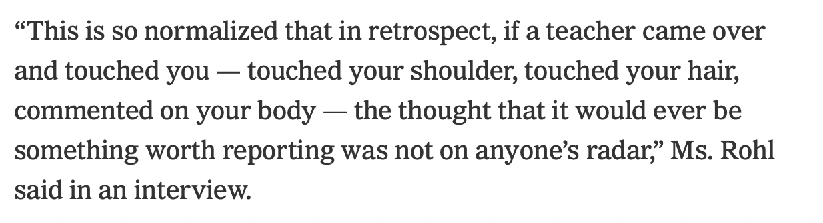

Slide 20
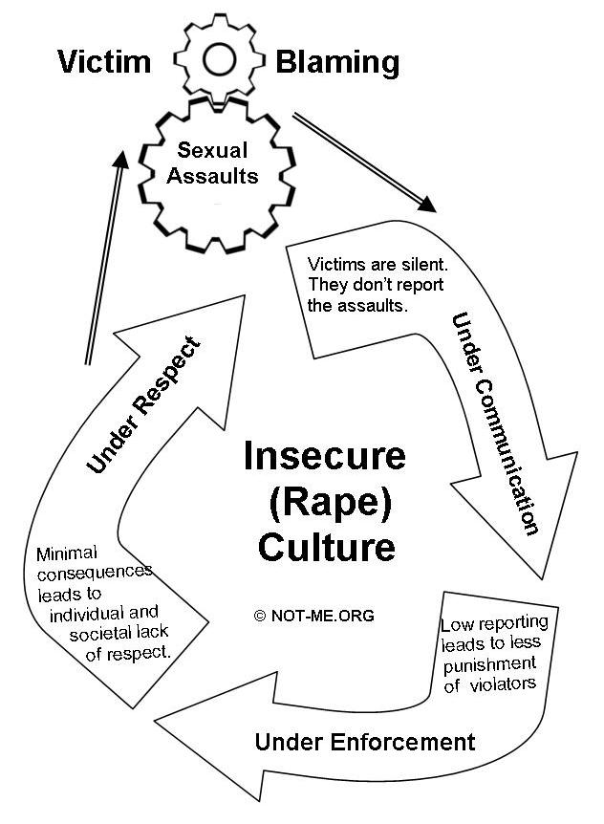

Slide 21
